Slide 1
Integrating and prioritizing mental health care in NCD programmes.
Melvyn Freeman: Non-communicable Diseases,
National Department of Health
Preferred (and more accurate) title.
Integrating and prioritizing mental health care in chronic disease programmes in South Africa
19 November 2016

Slide 2
What do we mean by chronic disease?
Chronic refers to a condition that continues or persists and will require management over an extended period of time (usually more than 6 months)
WHO defintion:
Long duration and generally slow progression
These definitions apply to a number of both physical and mental health diseases/disorders

Slide 3
Seventy seven percent (77%) of patients attending primary health services in South Africa do so for treatment/management of a chronic condition.

Slide 4
Prevalence of co-existing mental-physical conditions International statistics
Rates of depression in people with physical NCDs are two to five times higher than people without NCDs. Likelihood increases with multi-morbidities.
Rates of depression in people with HIV nearly twice that of the general population
Higher prevalence of alcohol misuse in people living with HIV (PLWHA) and tuberculosis

Slide 5
PC101 baseline trial data (N=4393) Co-morbidity of Depression in One or More Physical Conditions
38 clinics from Eden and Overberg districts in Western Cape

Slide 6
PRIME FDS data on co-morbidities, Dr Kenneth Kaunda District, North West (N= 2549)

Slide 7
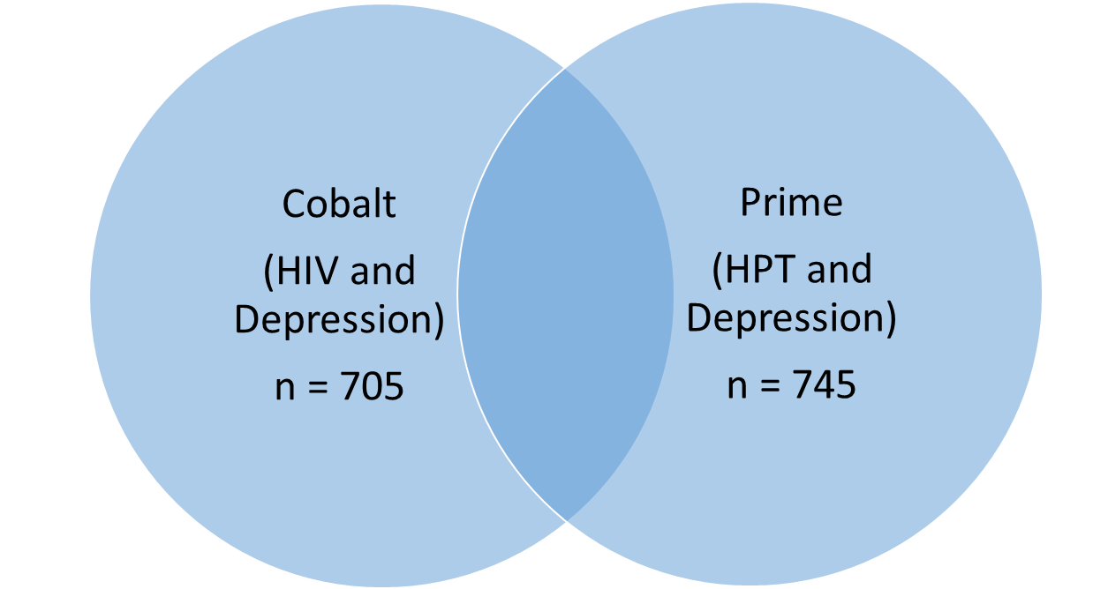
Baseline patient data from Phase 1 PRIME/COBALT trials (Dr Kenneth Kaunda district, North West)
(HIV,
HPT, Depression)
n = 305

Slide 8
Why is HIV so important to an integrated care model in South Africa?
South Africa has had to confront a massive HIV epidemic - while at the same time deal with a growing burden from NCDs.
HIV is now a chronic condition requiring chronic care management. Large financial and human resources have been put into fighting HIV and currently SA has the largest ART programme in the world with around 3 million people on treatment and is expected to go up to around 6 million in the “near” future.
The platform for providing chronic HIV care has been carefully planned and relatively well resourced.

Slide 9
Primary health care services
The primary health care approach (including the primary mental health care approach) has long suggested that services should be decentralized to the lowest level of health service and to a health worker that is competent to provide effective services.

Slide 10
Decentralisation of chronic care
From a chronic care perspective “stabilized” patients need not be seen (on a routine basis) by medical doctors and specialists. (It is debatable as to whether patients should also be initiated by nurses for example and this may vary depending on the condition)
Scarce specialized resources such as psychiatrists should be used for training of lower level workers, supervision and for taking referral of difficult cases, and not for seeing stable and routine patients.
In short stable chronic patients should be down referred to primary care for both physical and mental health.

Slide 11
Key Elements for treating chronic conditions
For the most part the approach to treating chronic diseases is the same no matter what the disease is. For example people with a chronic disease need to:-
be put on treatment at an appropriate point,
adhere to treatment
live a healthy lifestyle,
be supported (by a counsellor, group, family etc)
receive medicines at a convenient place and within a reasonable time frame,
receive check up at a regular interval from a health worker
be referred where there may be a problem and referred back.

Slide 12
Baseline Assessment in SA
Vertical chronic care services
Specific days for consulting chronic NCD patients, mental health patients, HIV etc.
Inefficient process flow at all facilities –
All patients wait in one area for vital signs monitoring- resulting in bottlenecks and extending patient waiting times
No signage directing patients to appropriate area for waiting
No patient scheduling mechanism in place - given only return dates for follow up-thus inappropriate staff allocation.
No mechanism for tracking defaulters
Poor quality of clinical records
Very little health promotion

Slide 13
The National Department of Health have embarked on redesigning clinical primary health care services through an Integrated Clinical Services Management Model (ICSM)

Slide 14
ICSM
Integrated Clinical Services Management
Acute and Minor Ailments
Unplanned
Chronic Disease Management
Planned appointments
MCWH-Preventive /Promotive
Planned Appointments

Slide 15
What are the potential gains of integrating all chronic care?
The (often excellent) platform created for rolling out HIV (often supported by donors) can be utilised to benefit all patients.
Many people have co-morbidities of chronic diseases and this will increase as more people living with HIV get older.
Coming for different treatments by different health workers on different days borders on absurdity in terms of time and money spent. This impacts negatively on the health service, the individual, their family, the employer, and the economy!
Holistic care is good care!

Slide 16
What is the ICDM?
Integrated Chronic Disease Management (ICDM) is a model of managed care that provides for integrated prevention, treatment and care of chronic patients at primary healthcare level (PHC) to ensure a seamless transition to ‘assisted’ self-management within the community by taking a patient-centric view that encompasses the full value chain of continuum of care and support.

Slide 17
What is the ICDM?
What chronic condition a person has is largely irrelevant – as long as the practitioner has sufficient understanding of the relevant condition!
Initial and ongoing training to ensure competence is thus essential.

Slide 18
Conditions included
-Non-communicable Diseases
Diabetes, Hypertension, IHD,C OPD, Asthma
-Persistent Communicable Diseases
HIV(on ART), TB
-Long term Mental Illness
Depression, Anxiety, Psychosis, E pilepsy,
Substance Abuse.
-Persistent Physical Impairments
Strokes, Cerebral Palsy

Slide 19
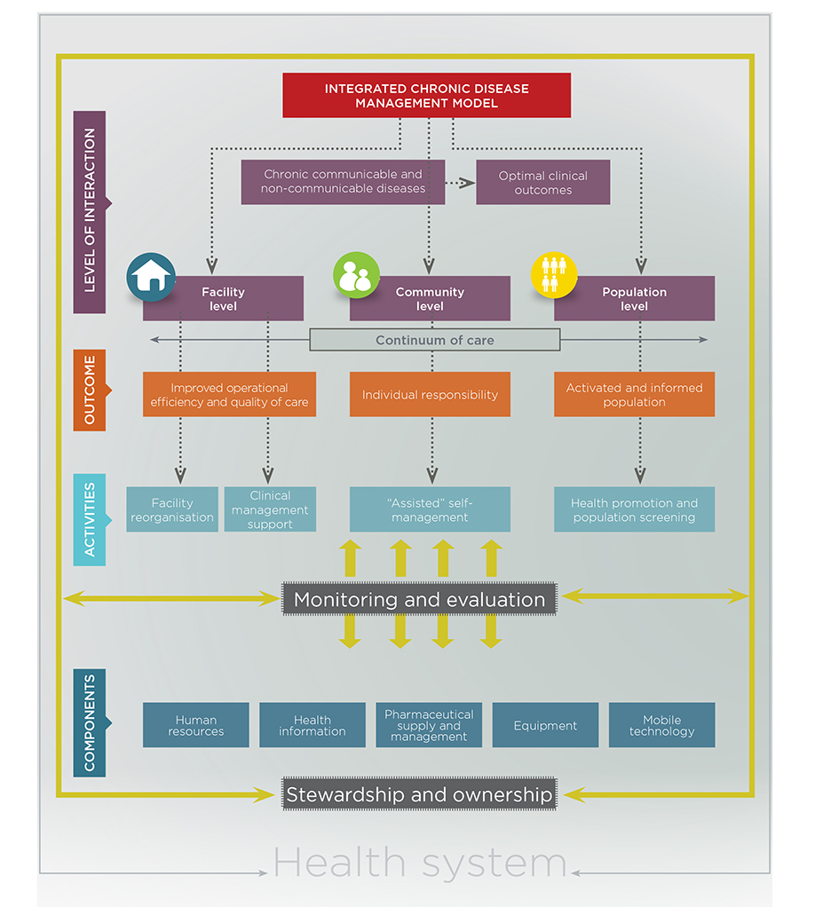

Slide 20
IDCM model components
HEALTH SERVICE RE-ORGANISATION
CLINICAL MANAGEMENT SUPPORT
ASSISTED SELF MANAGEMENT
Re-organisation of patient flow
Designated waiting areas
Designated consultation area
Designated vital signs station
Appointment scheduling
Single administrative point
Pre-appointment retrieval of clinical records
Integration of clinical care
Pre-dispensing of medication
Chronic patient record
APC training and application of algorithmic based clinical guidelines
Health promotion compendium.
Supervision and support by district clinical specialist teams
Health promotion and education at community level
Identification of at-risk patients within the household by point of care screening
Point of care testing and screening
Support groups and adherence clubs
Medication delivery (courier service)

Slide 21
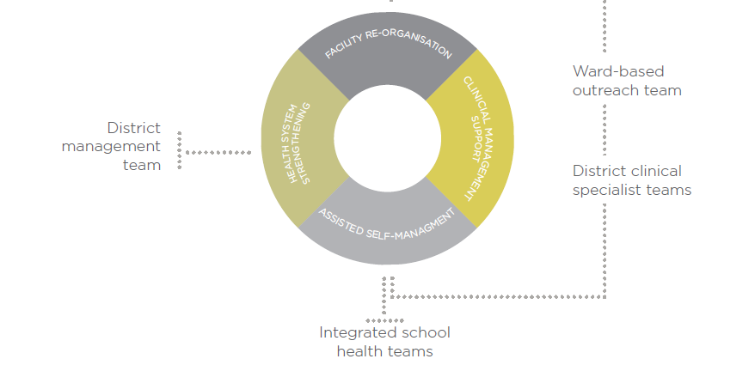
PHC clinic level- treatment and prevention of complications
Primary prevention & Screening
Household visits- adherence monitoring and identification of complications
Referrals
Oversight and addressing systemic challenges
Mentoring & supervision and strengthening of referral
Health Education & Awareness
Screening
Referrals

Slide 22
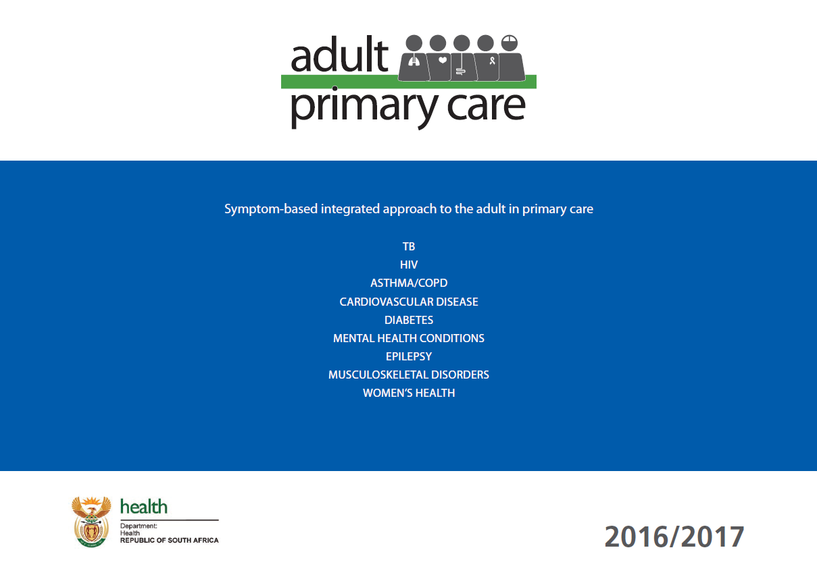
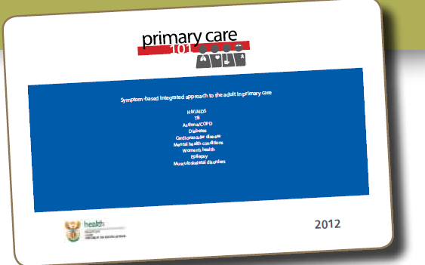
!

Slide 23
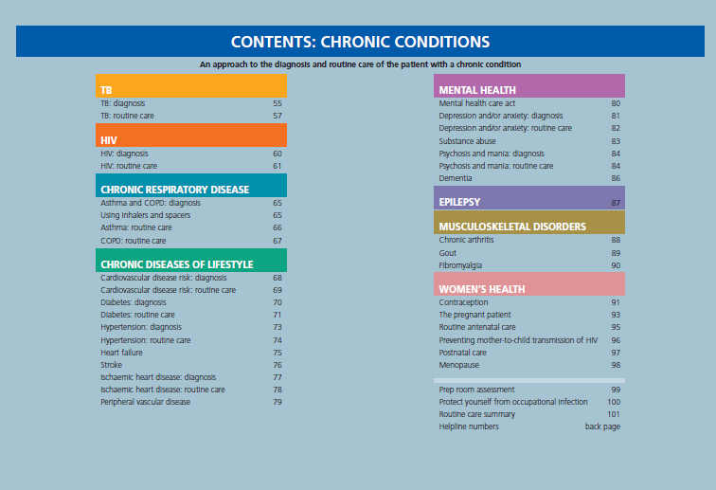
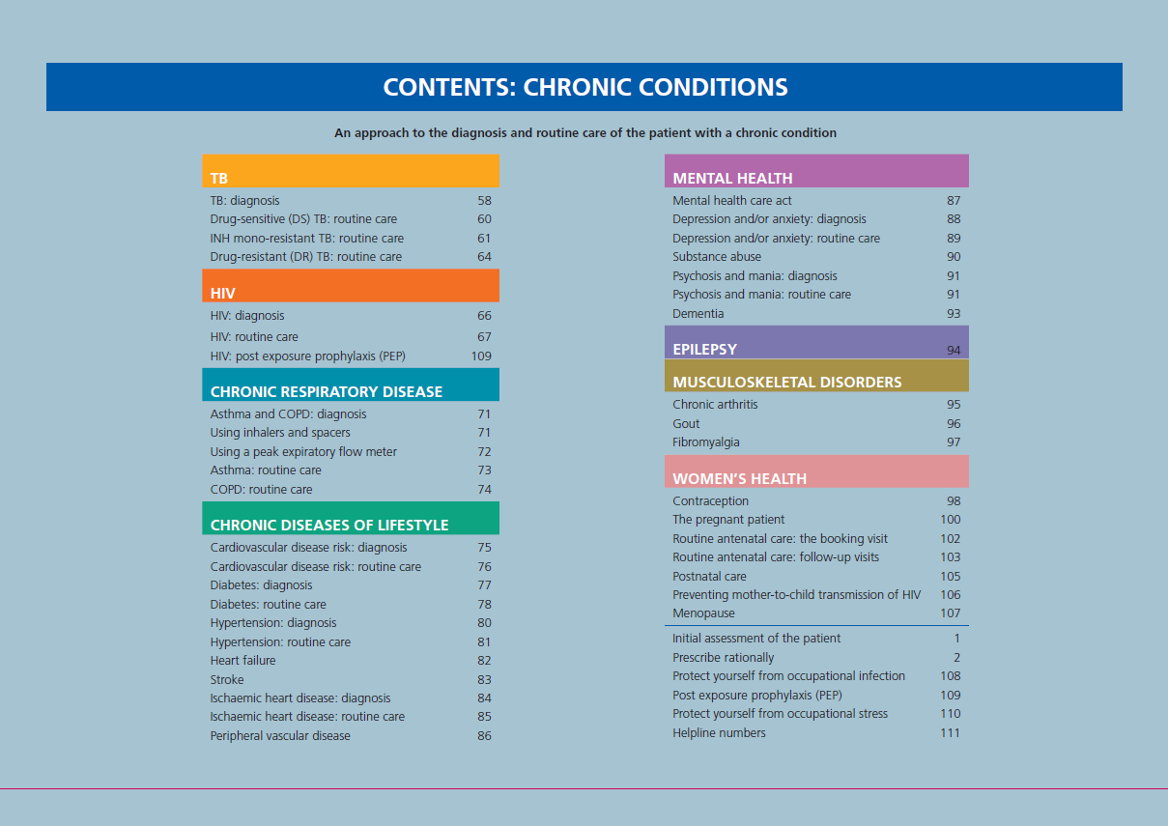

Slide 24
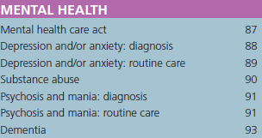
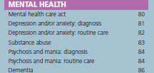

Slide 29
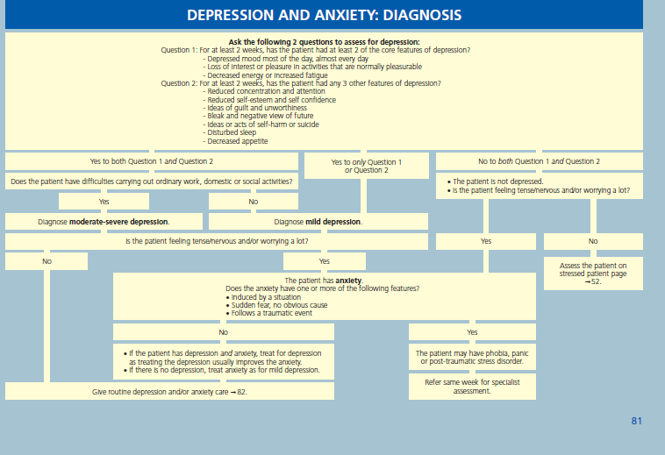

Slide 31
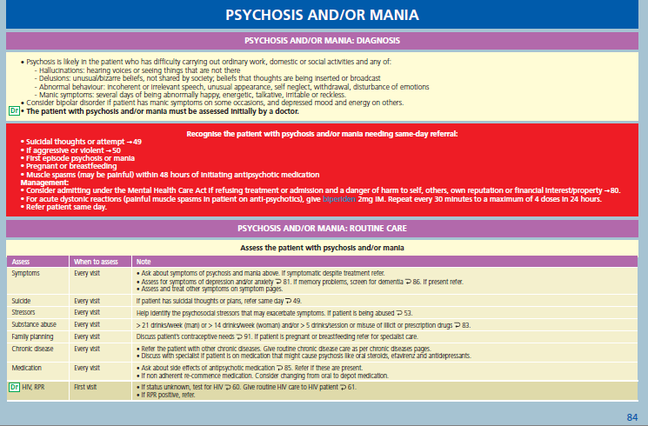

Slide 32
Chronic Medicine Access Programme for Public Sector Patients
The provision of an alternative chronic medicine access programme for public sector patients which includes:
Recruitment of patients on programme
Dispensing and distribution of scripts by contracted service provider
Contract services of pick up points more suitable to patient needs

Slide 33
Ward based outreach teams
Community health workers form an integral part of the system in terms of primary prevention, early identification of symptoms and referral to the clinic, but also to trace defaulters from the chronic care system.

Slide 34
Counselling services
What happens when a mental health condition is identified either as co-morbid with a chronic condition or independently requires intervention but is neither a chronic condition nor does it require medicine (given that we should not medicalize social problems)?
In the first instance the “treating practitioner” has guidelines in terms of APC of how to assist.
However where counseling is required it is not always easy. In some pilot sites lay counselors that have been appointed as HIV counselors have been trained to deal with mental health also.

Slide 35
An important question as we go forward and for other countries that examine integration of NCDs and mental health is, do we want to include all mental health conditions? And if not which conditions would most easily and feasibly be included?

Slide 36
Thank you!

